Slide 1
Demand Analysis

Slide 2
Demand Determinants (Factors Determining Demand)
1. General Factors :
Price of a product itself
Income of the consumer
Taste and Preference of consumer
Price of related goods (substitutes and complimentary goods)

Slide 3
2. Additional factors related to luxury good and durables
Consumers expectations of future price
Consumers expectations of future income
3. Factors related to market demand
Population ( Number of customers)
Socio Economic and Demographic Distributions of consumers
Advertising
Sales Promotion

Slide 4
Price and Demand
Demand: Demand in economics means desire to buy backed by adequate purchasing power.
Demand Function:
A mathematical expression of the relationship between quantity demanded of the commodity and its determinants is known as demand function, when it related to the market it is called Market Demand Functions.

Slide 5
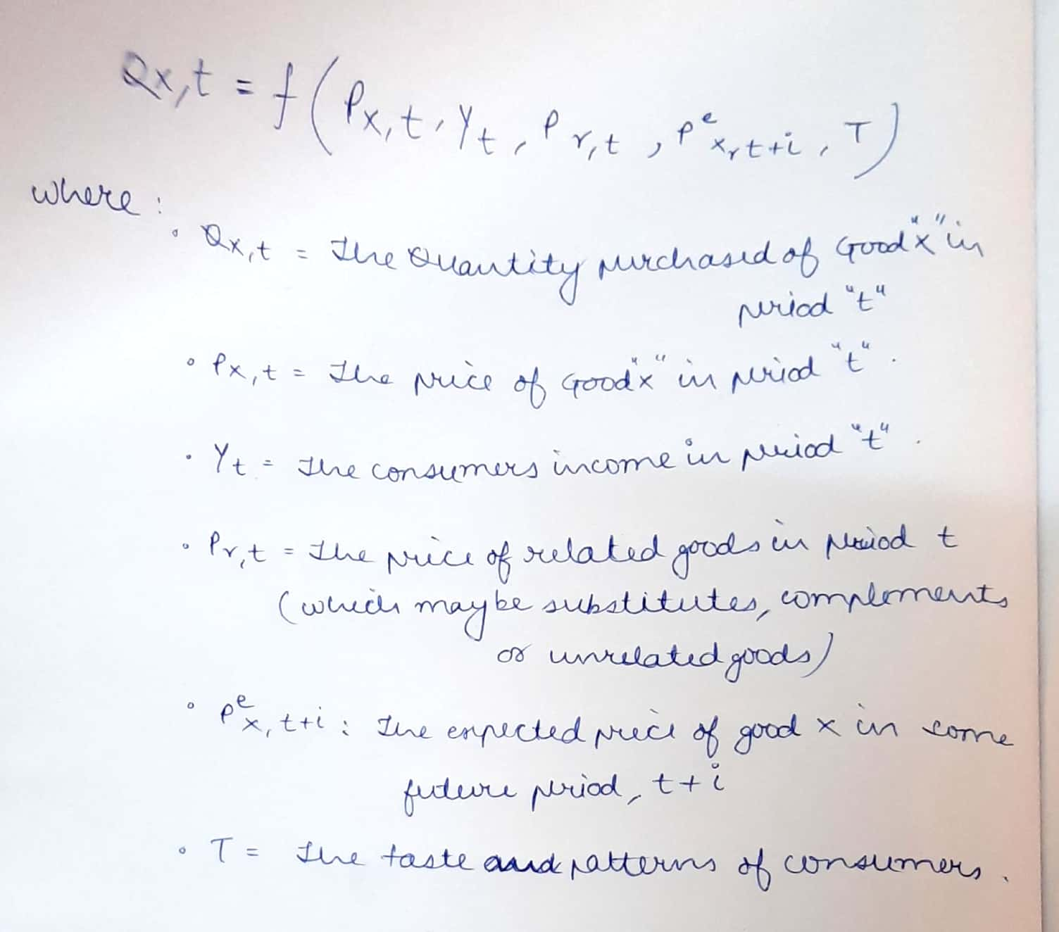

Slide 6
Market Demand Function
Q dx = f (Px, Y, P1,…….., Pn-1, T, A, Ey, Ep, P, D, u)
P- Population (Size of the market)
D- Distribution of consumers in various categories depending on age, income, sex,… (Market Segments)

Slide 7
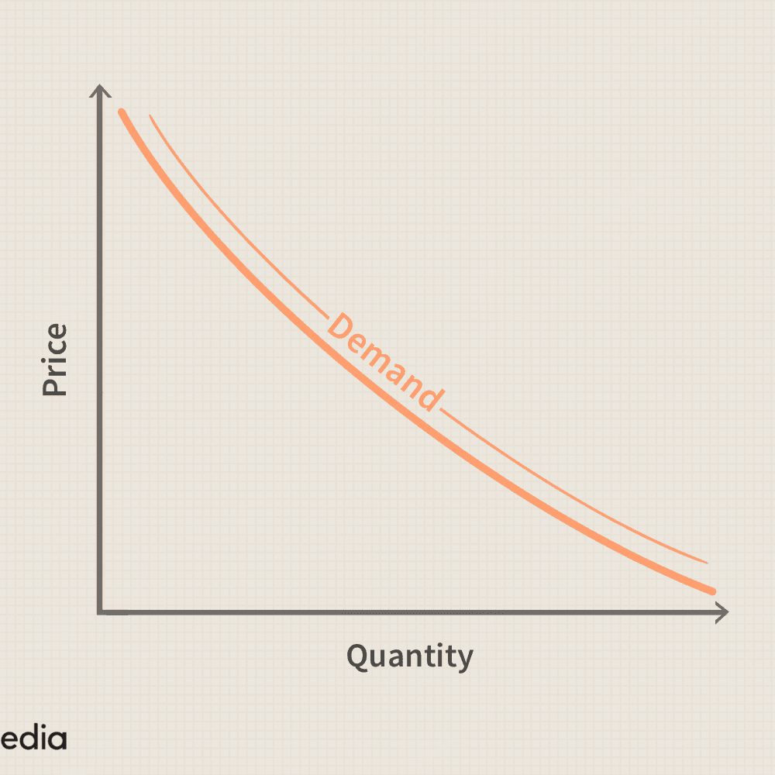
The relation of price to sales is known in economics as the “law of demand”
“Higher the price, lower the demand, and vice versa, other things remain the same”

Slide 8
Supply curve
Where as supply curve shows, willingness of producer (supplier) to offer quantity at particular price.
From supply curve we can see that more the prove, more quantity will be offered by the producer (supplier) if stock exists.
Price Y
Quantity X

Slide 9
Generally, Y a dependent variable shown on Y axis and independent variable, is shown on X axis. But here, Quantity (Q) on X axis and Price (P) on Y axis.
Demand Curve –
Price Quantity relation between Q and other variables are not shown by “Demand Curve”, it tells a) At particular price – what is the max, a consumer can purchase
b) For particular Demand (Q), what price.
In algebraic form : Q = f (P)

Slide 10
Chief Characteristics of Law of Demand
Inverse Relationship ( Between price and quantity )
Price, an independent variable and Demand, a dependent variable (under the law of demand, the effect of price on demand which is examined, and not the effect of demand on price)
Other things remain the same. (eg. One or more such factors, say, income, substitute’s price, consumer’s taste and preferences, advertising and sales promotion….)

Slide 11
Reasons underlying the law of demands
Income Effect: The fall in the price of a commodity leads to and therefore, is equivalent to an increase in the income of the consumer because now he has to spend less for purchasing the same quantity as before. So a part of money so gained can be used for purchasing some more units of the commodity. When price rises – reverses
Substitution Effect: When the price of the commodity falls consumer tends to substitute that commodity for other commodity (expensive). Conversely, when the price of a commodity rises, other commodities will be used in its place at least to some extent. Therefore, a fall in the price of a commodity increases demand and vice versa.

Slide 12
Exceptions to the law of demand
There are some goods purchased mainly for their “Snob appeal” or orientation. Veblen called “conspicuous consumption”.
Price rises- snob appeal rises – rise in demand.
If price falls – their capacity to perform the function of ostentation diminishes. (Veblen goods – diamond)
Speculative market, a rise in price creates more purchase frequently and vice versa. Eg. Share market, some industrial

Slide 13
The Giffen case:
- Giffen found - in 19th century – Ireland people were so poor that they spent
major income on – potatoes
Small part on meat.
When price of potatoes increased, economized on meat to maintain consumption of potatoes
Further to fill the resulting gap - they had to purchase more potatoes.
Thus the rise in price of potatoes increases its sales rather than decrease.
( but such case happen only when the considerable income is spent on inferior good)

Slide 14
Individual Demand and Market Demand
Demand at given price -by Individual purchaser – Individual demand
Total Quantity Demanded by all purchasers – Market demand
Market Research & Law of Demand
Price elasticity of Demand :
Law of demand tells us about only direction of change, but not the rate at which the change takes place

Slide 15
“ The degree of responsiveness of quantity damanded to change in price." - gives rate of change
ep = Proportionate change in the quantity demanded
Proportionate change in price change in price change in price
Change in Quantity demanded / Quantity demanded
Therefore, ep = Change in price / Price

Slide 16
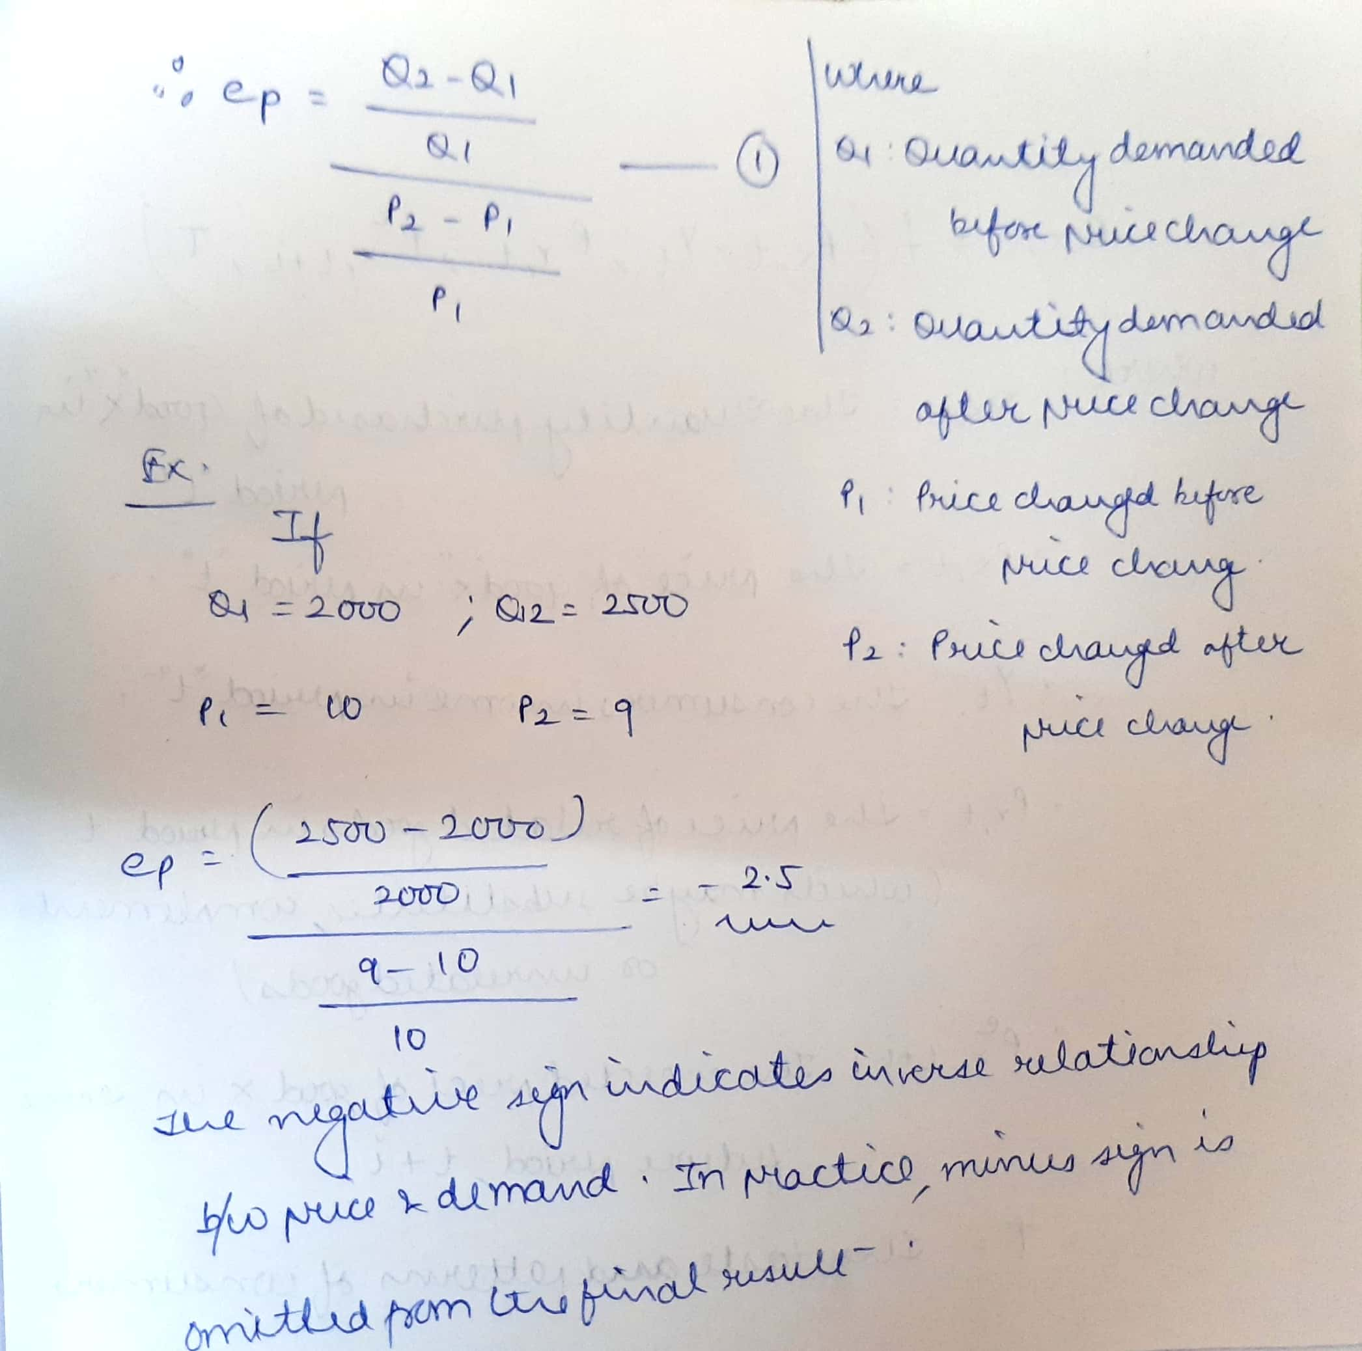

Slide 17
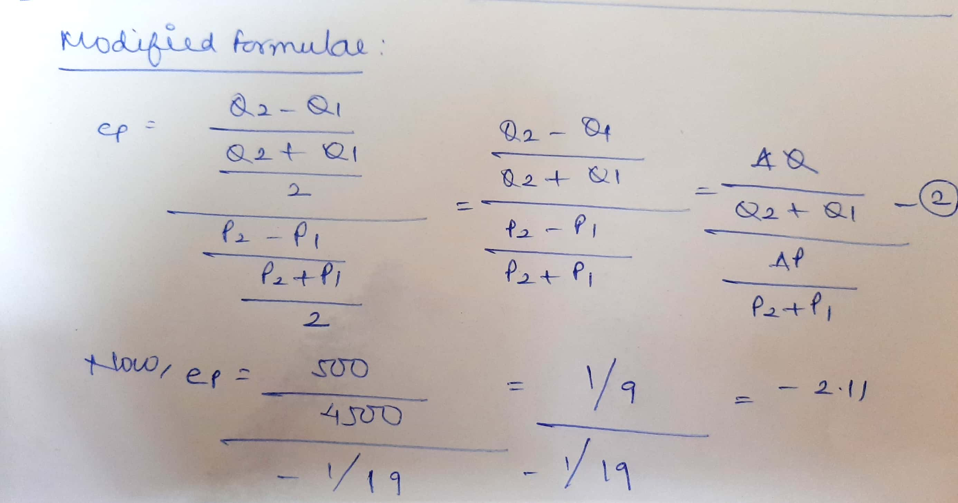

Slide 18
Interpretation:
A one percent reduction in price will result it a 2.5 % increase in quantity demanded from 1st formula and 2.1 % increase in quantity demanded according to the modified formula (2).
Here we are limiting our selves to elasticity only. (2 finite points on curve )
Where as at particular point, point elasticity can be found out by:
Point elasticity = dQ / Q = P . dQ
dP/P Q dP

Slide 19
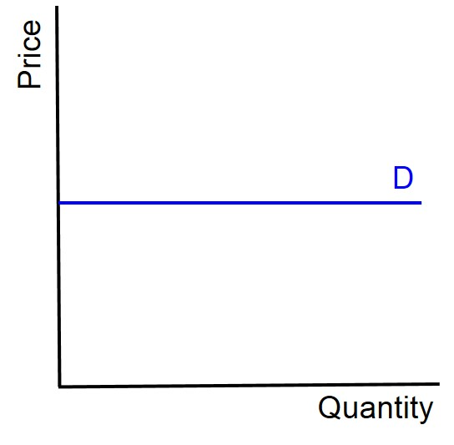
Types of Price Elasticity
Perfectly Elastic Demand
No reduction in price is needs to cause an increase in demand. Firm can sell the quantity it wants at the prevailing price but not at all even a slightly higher price.
Curve – Horizontal
Num. Expression - ∞

Slide 20
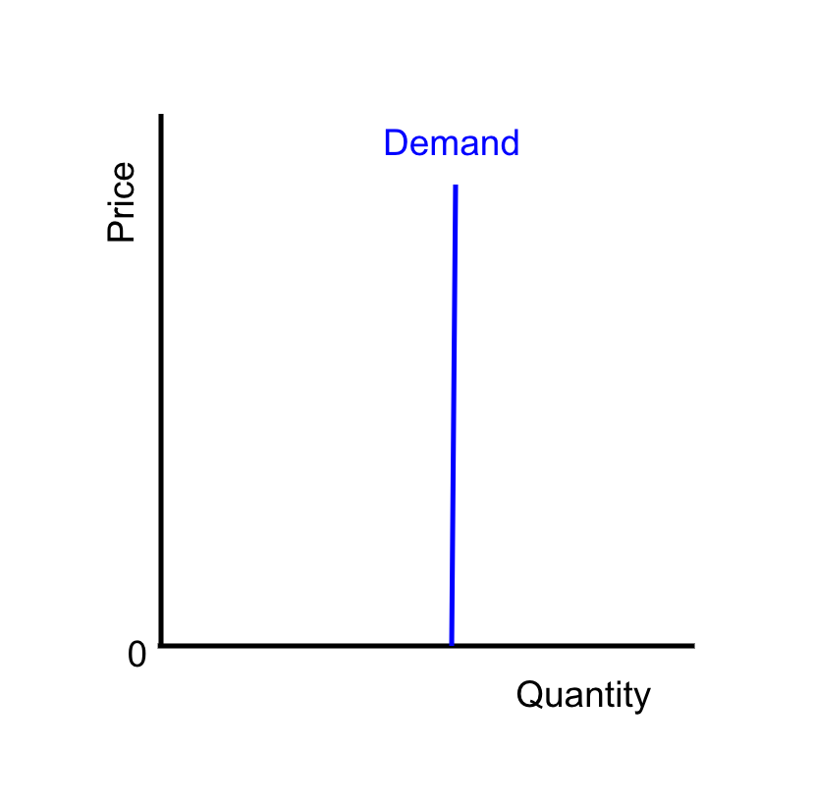
2. Perfectly inelastic Demand
Where a change in price is howsoever large, causes no change in quantity demand
Curve – Vertical
Num. expression - 0

Slide 21
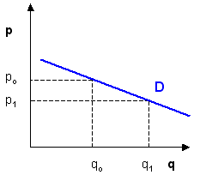
3. Demand with unity elasticity:
Proportionate change in price cause an equal proportionate change in the demand shape of the demand curve- rectangular hyperbola.
Num. Expression -1
4. Relatively elastic demand:
Reduction in price leads to more than proportionate change in demand
Curve – Flat
Num. Expression > 1

Slide 22
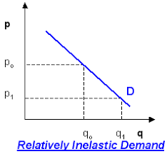
5. Relatively Inelastic Demand
Reduction in price less than proportionate increase in demand
Curve – Steep
Num. Expression < 1

Slide 23
Factors Determining Price Elasticity of Demand
Nature of commodity: Demand of necessities is generally inelastic (salt), demand of luxury goods – elastic generally
Extent of use: More use – more elastic (steel)
Range of substitutes: More substitutes - more elastic
Income level: People will high income less affected by price change

Slide 24
Proportion of Income Spent on the commodity:
Where an individual spends only a small part of his income on the commodity, the price change dost not materially affect his demand for the commodity. Eg. Match box, salt – inelastic
Urgency of Demand:
The availability of substitutes
Habit and social custom
Salt – less elastic – inelastic
Cigarettes – less elastic - inelastic

Slide 25
Durability of commodity: Durable of repairable more durable or repairable – more elastic the demand ( or if price rise get repaired it and wait for reduction in price of at least we it for long time )
Purchase frequency of a product: If the frequency of purchase mix – high elastic

Slide 26
Revenue Relationships
Average Revenue: Total receipts from sales dividend by the number of unit sold.
AR = TR / Q
Total Revenue : TR = P. Q [ P : Price, Quantity : Q ]
Incremental Revenue: IR = R2 - R1 = ∆ R
Marginal Revenue: Additional revenue which would be earned by selling on additional (marginal) unit of a firm’s product.
MR = R2 – R1 / Q2 – Q1 = ∆R / ∆Q

Slide 27
Difference between IR and MR
IR is the change in total revenue irrespective of the change in sales whereas MR is the change in total revenue per unit change in sales.
IR revenue is not confined to the effects of price change. It rather measures the effect of any kind of managerial decision on total revenue.
IR = R2 – R1 = ∆R
MR = R2 – R1 / Q2 – Q1 = ∆R / ∆Q

Slide 28
Elasticity of Demand and Total Revenue
Change in Price | e>1 | e=1 | e<1
Rises | TR falls | TR unchanged | TR rises
Falls | TR rises | TR unchanged | TR falls

Slide 29
Relationship between Average Revenue, MR and e:
AR = MR x e / e-1
MR = AR x e-1 / e
e = AR / AR – MR

Slide 30
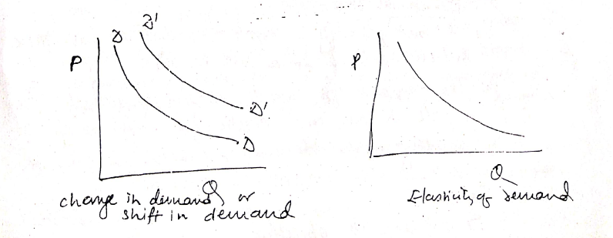
Change in demand and elasticity of demand
In economics, both are different “change in demand” occurs when price dost not change but demand changes due to some other factors.
(Income, etc)
Where as elasticity of demand refers to that change in demand which occurs due to change in price, other factors remaining the same.
In former case, shift of entire demand curve and in later case, changes on the same curve.

Slide 31
Some Business applications of price elasticity
Price discrimination: A monopolist adapts price discrimination policy only when the elasticity of demand of different consumers or submarkets is different. Consumers – inelastic changed more
Public Utility Pricing: Monopoly – railway, water supply.
Price discrimination according to elasticity
● Join Supply: Wool and mutton.
● Super market: Slightly less price for goods with elastic demand

Slide 32
● Use of machines: If elastic demand may generate employment as more capacity can be utilized, when inelastic demand – may be reverse case
● Factor pricing : The factor having price inelastic demand can obtain a higher price than those with elastic demand workers producing products having inelastic demand can easily can their wages raised.
● International Trade:
A country benefit: Exports of products as have price inelastic demand for a rise in price.
The demand for imports should be inelastic for a fall in price and elastic for a rise in price.

Slide 33
c) Deciding upon devalue a country’s currency or not – price elasticity of demand. If demand is inelastic, devaluation would fail to achieve its objective.
Shifting of Tax Burden: If demand is elastic he will have to bear the tax burden himself, otherwise demand for his goods will go down.
Taxation Policy: Govt. can easily raise tax revenue by taxing commodities which are price inelastic.

Slide 34
Income & Demand
Basic demand determinants- useful in planning sales, allocating territories etc.
Important aspects:
Consumption function : refers to the relationship of Total expenditure on consumption to total income.
The long-run relation of consumption to income is somewhat Stable, and expenditure on consumption is regularly about 85 to 90 % of the income.
In Short -run, the consumption function recorded great instability.
During periods of economic prosperity expenditure on consumption tends to increase absolutely but decrease as a % of income on the other hand, in periods of depression, consumption declines absolutely but the expenditure on consumption increases as a % of income.
In under developed countries like India where people live below the subsistence level, the propensity to consume is very high. Any increase in income of the people with low income, is likely to be spent on consumption goods.
But still some limitations are there as some other factors also affect the consumption decision .

Slide 35
Product consumption (fn)- relationship between total income and sales of particular products.
personal consumption
expenditure
Disposable personal income
Differences in Regional income - diff. in purchasing power in diff. region.
find out coefficient income sensitivity.
ratio of % change in expenditure (in money terms to % changes in income)
Income expectation and demand :
applicable to consumer durable generally

Slide 36
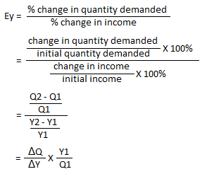
Income Elasticity of demand:
The degrees of responsiveness of quantities demanded to a given change in income.

Slide 37
y1= 1000 (Rs)
y2= 1100
Income Q1= 10 kg sugar
Q2= 12 kg sugar
e y = 1.99
Quantity Demanded
So we can say, the demand for sugar is quite income elastic.
Zero income elastic (salt)
Negative income elasticity (inferior good)
Positive income elasticity (superior good)

Slide 38
PRICE OF RELATED GOODS AND DEMAND
Substitutes and Complements
Cross Elasticity of DEMAND
The proportionate change in the quantity demanded of a particular commodity in response to a change in the price of another related commodity.
% change in quantity demanded (good A)
% change in price (good B)
e c = Qx2 – Qx1 / Qx2 + Qx1
P z2 – P z1 / P z2 + Pz1
If cross elasticity – Positive (+ve) – substitutes goods
If cross elasticity- Negative (-ve) – Complements goods

Slide 39
Cross Elasticity of Prices:
Px . E py = P y2 – Py1 / Py2 + Py1
Px2 - Px1 / Px2 + Px1
For substitutes C.E. of price is positive
For complements C.E of price is negative
C.E. should range from +1 (perfect substitutes) to -1 (perfect complements) Theoretically, but in reality measure may go beyond these due to error in data and to various other extraneous factors.

Slide 40
ADVERTISING & DEMAND
The important fn. of advertising in context of demand
to shift the demand curve to the right
to reduce the elasticity of demand.
however, adv. has a cost
Sales (Rs)
Advertising Outlay (Rs)

Slide 41
The salient features of the advertising - sales relationships are :
Certain amount of sales is possible even without any adv.
Other things i.e. price, quality, channels of distribution and similar factors affecting the sales remaining the same, there is a direct relation. between the extent of advertisement and the volume of sales. This the increase in the expenditure on advertising is likely to lead to an increase in sales.
Up to a point an increase in 'advertisement will lead to a more than proportionate increase in sales. But beyond this point an increase in advertisement will lead to a less than proportionate lncrease in sales till the saturation point is reached after which there will be to increase in sales
Advertising elasticity of Demand : (promotional elasticity)
ea = Proportionate change in Sales
Proportionate change in Adv. Expenditure
Or e a = Q2 – Q1 / Q2 + Q1
A2 – A1 / A 2 + A1

Slide 42
Factors affecting Advertising elasticity of Demand :
1.The stage of the product's market development
2. The extent to which competitors react to the adv.
3. The quality and quantity of the co's adv. In past and present relative to that of competitors
4. The influence non adv. Determinants of demand price and income
5. The time interval that elapses between adv. Expenditure and response of sales to the expenditure, which is difficult to predict
6. The delayed effect co’s past adv. And the extent to which it affects current and future sales.

Slide 43
Determining Advertisement Outlays:
1.% of sales approach : fix % of past, present and expected sales on adv. Outlays.
2. All you can afford approach of profit or cash funds more profitable more adv.
3 Return on Investment approach
4. competitive parity Approach what other firms are spending on adv. in industry
5. objective and Task approach: define objective - Target outline task media - determine cost and measure-monitor

Slide 44
Economic Implications of Advertisement:
Informing consumer - Broadening Market
Lowering selling costs (low cost per contact -advantage of adv.)
Encouraging competition
Waste of resources ( increases prices –cost to consumer) & Oligopoly and Market concentration

Slide 45
Demand Distinction
Producer's and consumers goods
Durable and non-durable goods
Derived demand and autonomous demand
Industry demand and company demand
Short run demand and long run demand
Short term demand fluctuation and long term trend
Total market and market segment

Slide 46
Demand forecasting : A forecast is a prediction or estimation of a future situation under given condition.
Passive forecasts: where Prediction about future is based on the assumption that the firm does not change the course of its
action –
Active forecasts: where pre casting is done under the condition of likely future changes in the actions by the firm.
Purpose of forecasting demand:
in short run forecast seasonal patterns are of price importance - useful for suitable sales policy and proper scheduling of out put in order to avoid over-stocking or costly delays in meeting the orders, - necessary modification in advertising and sales techniques.
long run forecasts are helpful in proper capital planning - deciding upon prod. capacity, man power planning etc.

Slide 47
Demand forecasting :
May be undertaken at three different level
1. Macro level - business conditions over the whole economy measured by an appropriate index of industrial prod" national
income or ' expenditure
2. Industry level - prepared by different trade association
3. Firm level – Companies

Slide 48
Steps in Demand Forecasting:
Identification of objective
Determining the nature of goods under consideration
Selecting a proper method of forecasting
Interpretation of results.
Methods of forecasting
1.Expert opinion method
2. Delphi Method : It consists of an attempt to arrive at a consensus in an uncertain area by questioning a group of experts repeatedly until the response appear to converge along a single line on the issue causing disagreement are clearly defined. The participants (experts) are supplied the responses to previous questions from others in the group by a coordinator or leader. even including reasons.
3. Survey of Buyers Intention useful for short run
4.collective opinion ( sales force polling): restricted to short run only

Slide 49
5. Analysis of Time series and Trend projections :
Past sales data with time are arranged in chorological from yield 'time series & trend line can be fitted through a series either by means of
Statistical method such as least square or visually by judgement
challenges at turning points, or at break down of time series.
Four sets of factor has to be seen:
Trend(t), seasonal variation (s), Cyclical fluctuations (c) and irregular forces (I).
Treat the original time series data (o) by Expressing o=TSCI
So for eliminating effects of these all four usual practice.

Slide 50
Usual practice is first calculate trend from usual data (D).
Then trend values are eliminated (TSCI / T). Then calculate seasonal index, used for removing seasonal effect (SCI / S) …..
Linear Trend: Sales = a + b T
S = a + ∑ T
LS = Na + b ∑ T
∑ S T = a ∑ T + b ∑ T ^2
Find out a and b, So: S = ( ) + ( ) T and we can get value of S for any further year.

Slide 51
Non linear trends:
Polynomial trends: S= a-bT+cT²
S= a-bT+cT²-dT³
Exponential trend: S= aeᵇᵗ
log S= log a +b logT
Double Log trend: S= aTᵇ
log S= log a + b logT

Slide 52
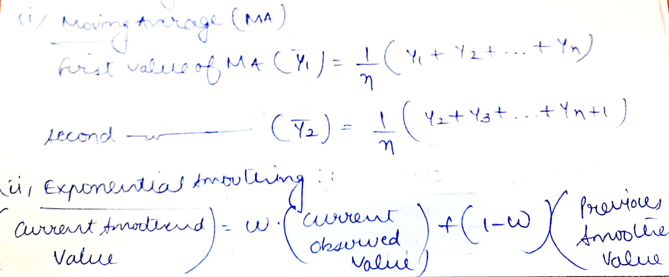
Smoothing Method
S t = W Y t + ( 1 – W)

Slide 53
7.Use of Economic Indicator Method
Construction contracts sanctioned for the demand of building wall like cement
Personal income for the demand of consumer goods
Automobile registration for the demand of car accessories
Agricultural income for the demand of fertilizer
Year | Farm Income Index (X) | Sales of Tractors (Y) | X 1 | Y 1 | X 1 Y1
1 | 100 | 110 | 10 | 11
2 | 110 | 130 | 15 | 13
3
4
5
n = 5 |  |  | ∑ X 1 = | ∑ Y1 = | ∑X1. ∑ Y1
X 1 ^2

Slide 54
∑ Y 1 = n a + b ∑ X 1
∑ X1 Y1 = a ∑ X1 + b ∑ X1 ^2
Y = n ( ) + ( ) X
8. Controlled experiments
9. Judgemental Approach

